Slide 1
8. Monitoring & Alerting
ADVANCED
OPERATIONS
TRAINING
© Copyright Scality 2022
RING 8.5

Slide 2
Monitoring & Alerting
At the end of this module, you will be able to …
… know which Scality services to monitor,
… and leverage Grafana, Cloud Monitor, ElastAlert and other monitoring tools.
Notes:
Last update: 20180410

Slide 3
Contents
Monitoring Recommendations
Component States
Grafana
Cloud Monitor
ElastAlert

Slide 4
Monitoring Recommendations
RING 8.5

Slide 5
Server Monitoring
Hardware:
Operating system RAID 1 volume state
RAID card cache status
Power supply status
OS:
Track /var usage
TCP retransmits
Load average
Swap utilization

Slide 6
RING Monitoring
RING Status
Identify failed servers and/or disks
Capacity warnings
RING Utilization
Tracking time to 80% used
RING Latency
Identify networking issues
Identify failing/faulty hardware

Slide 7
Monitoring ElasticSearch
Cluster status
State should be green
active_shards_percent_as_number should be 100
Scality Indices
The number of Scality indices should remain below 45
Curator is responsible for pruning indexes to avoid infinite growth

Slide 8
Monitoring S3C
S3 Healthcheck
The S3 stack is comprised of several microservices
The healthcheck URL monitors the entire S3 stack
S3 Request Latencies

Slide 9
Component States
As reported on the RING Administration Interface
RING 8.5

Slide 10
Node State Lifecycle
N/A
Register server to Supervisor
Remove server from Supervisor
AVAILABLE
Newly installed node
Add to RING
Static state, only an
action can change it
DSO CHANGING
Remove from RING
NEW
Temporary state, automatically
changes to the next when done
Remove from RING
Assign Key
OUT OF SERVICE
Manually Join
or Auto-Join
LOADING
Stop process
LEAVING
SPLIT, LOOP*
Start process
OFFLINE
Leave
(*) will be reflected on the RING state
RUN
Stop process

Slide 11
Node State Lifecycle (2)
Node State | Description | RING State | Criticality
OFFLINE | Registered to the Supervisor, but cannot be reached |  | Info/Critical
AVAILABLE | Registered to the Supervisor, but not assigned to a Ring yet. |  | Info
NEW | Assigned to a Ring, but not assigned a key ID yet. |  | Info
OUT OF SERVICE | The node is currently out of the RING. It has been assigned a key ID. | INCOMPLETE | Warning
RUN | The node is in the RING and accepts object and key requests. | RUN | Info
LOADING | The node is loading; The node might have been rebooted, or re-read, etc. Goes to OUT OF SERVICE when done. |  | Info
LEAVING | The node is leaving the RING; transitioning from RUN to OUT OF SERVICE, e.g. after a Leave action. |  | Info
DSO CHANGING | The node is removed from the RING; transitioning from OUT OF SERVICE to AVAILABLE, e.g. after a Remove action. |  | Info
LOOP | A node points to an incorrect successor node. Critical when lasting more than a minute. | LOOP | Info/Critical
SPLIT | The node is not linked to the main Ring. Critical when lasting more than a minute. | SPLIT | Info/Critical

Slide 12
Other Node States
Node State | Description | RING State | Criticality
BALANCING (SRC) | A node holds some objects that do not belong to its key range. | BALANCING | Warning
BALANCING (DST) | Some objects that belong to a node are currently held on some other node. | BALANCING | Warning
DUPLICATE KEY | The node holds the same key ID as another node. | DUPLICATE KEY | Critical
CONFIG MISMATCH | The configuration set on the node is different than the configuration registered in the Supervisor. A Push conf command will update the running node with the configuration in the Supervisor. | CONFIG MISMATCH | Warning
DISK FULL | The disk usage limit (the Disk full percent parameter, set in the RING Administration window) has been reached. | DISK FULL | Critical
DISK USAGE WARNING | The disk usage limit, (the Disk warn percent parameter, set in the RING Administration window) has been reached. | DISK WARNING | Warning
DISK ERR* | The node has at least one disk that is reporting an error. (*) Not a RING state. |  | Critical
DISK OFFLINE* | The node has at least one disk that has been marked out of service permanently (OOS_PERM), automatically or manually. (*) Not a RING state. |  | Warning
ARC_REBUILD_NOK | At least one node cannot reach the local srebuildd component. This state is deactivated when affected nodes leave a RING or restart, or when a rebuild successfully contacts and rebuilds an ARC key. | ARC_REBUILD_NOK | Warning

Slide 13
RING States
The RING is an aggregate of nodes, therefore a RING state will reflect the state of one or all of its nodes (see previous slides).
RING states that are different from the nodes’:
State | Description | Criticality
MISSING NODE | The Supervisor does not recognize one or more servers in the RING (e.g., the administration interface has not been configured for the server). | Critical
INCOMPLETE | The number of running nodes is fewer than expected. | Critical
NOT STABILIZED | There is a problem with the key of a node's successor in the RING. Usually appears with SPLIT and LOOP states. Critical when lasting more than a minute. | Info/Critical
TIER ID MISMATCH | One of the nodes in the RING is not configured with the proper Tier ID and is causing synchronization problems for Tier1Sync mechanism. | Warning
ARC_REBUILD_NOK | At least one node cannot reach the local srebuildd component. This state is deactivated when affected nodes leave a RING or restart, or when a rebuild successfully contacts and rebuilds an ARC key. | Critical

Slide 14
Connector* States
State | Description | Criticality
OK | The daemon is running properly. This does not mean that the configuration is functional. | Info
DOWN/OFFLINE | The connector daemon is unreachable. | Critical
NEED RELOAD | The static configuration has been updated, but the running configuration has not yet been changed. | Warning
CONF MISMATCH | An error is raised on any connector in a volume when a configuration is pushed. | Warning
(*) not including the S3 connectors and XDM/Zenko

Slide 15
Grafana
RING 8.5

Slide 16
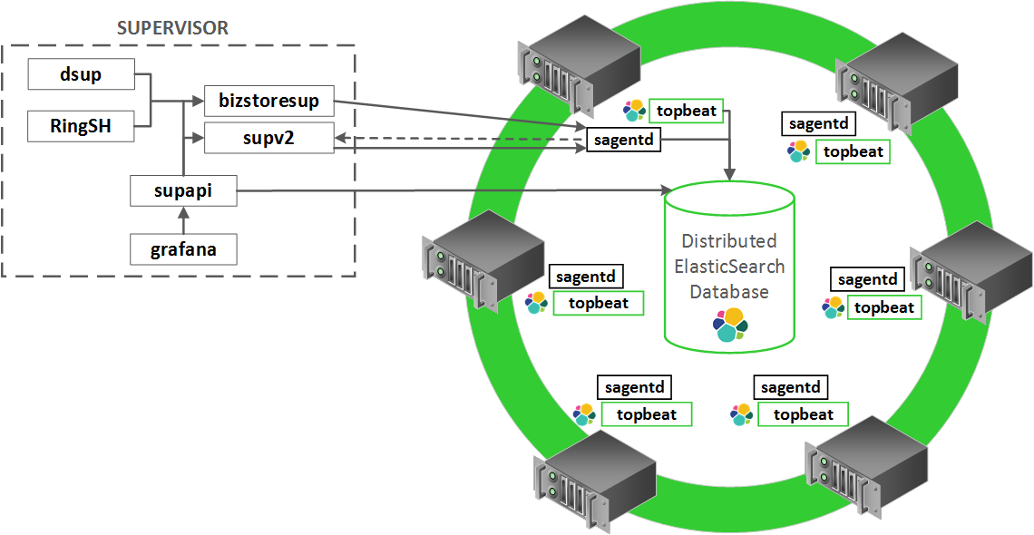
Grafana Overview
UI Shortcut: http://<supervisor_IP|hostname>/stats
For more information, check out “Using Grafana” in the Scality RING Operations guide found on 🔗https://documentation.scality.com.

Slide 17
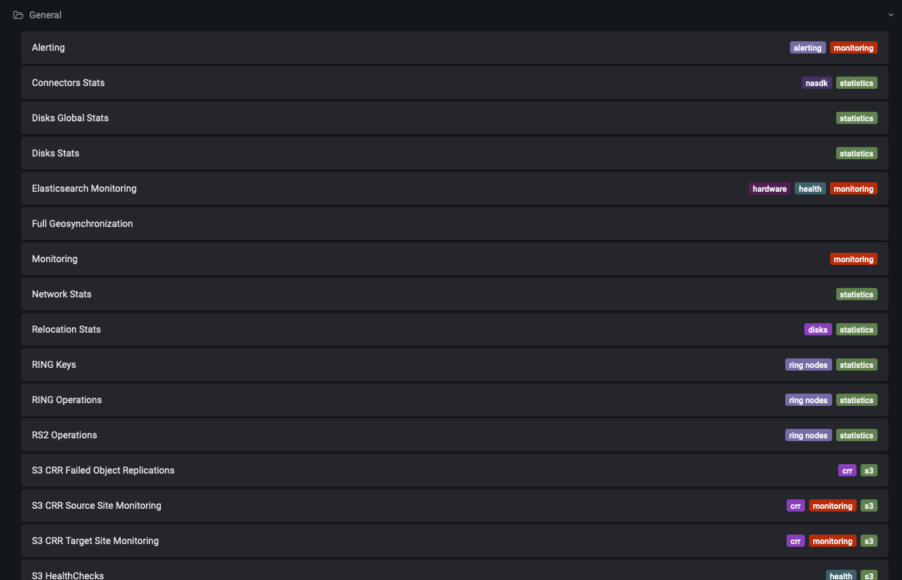
Available Dashboards (Demo)
Notes:
https://support.scality.com/hc/en-us/articles/360051680931-Understanding-Grafana-Graphs

Slide 18
Cloud Monitor
RING 8.5

Slide 19
Cloud Monitor Overview
Cloud-based monitoring system that:
Helps determine RING capacity for future growth.
Allows customers and Scality Support to quickly view RING component states.
Provides real-time contextual and predictive analytics
Raises proactive alerts, sent automatically through a number of different mechanisms, including email and chat rooms.
For information, check out “RING Monitoring” in the Scality RING Operations guide found on 🔗https://documentation.scality.com.

Slide 20
Cloud Monitor
Composed of a lightweight daemon running on the Supervisor machine: halod.
Requires access to:
the Supervisor,
ElasticSearch cluster,
app.netuitive.com port 443.
There are two flavors of Cloud Monitor:
Light: the standard version (included free of charge), monitors 18 Scality metrics per RING.
Full: included with the Dedicated Care Service, monitors 100 Scality metric types.
Contact Scality Support for availability and cost
Notes:
Full can lead to 10s of thousands of metrics sent

Slide 21
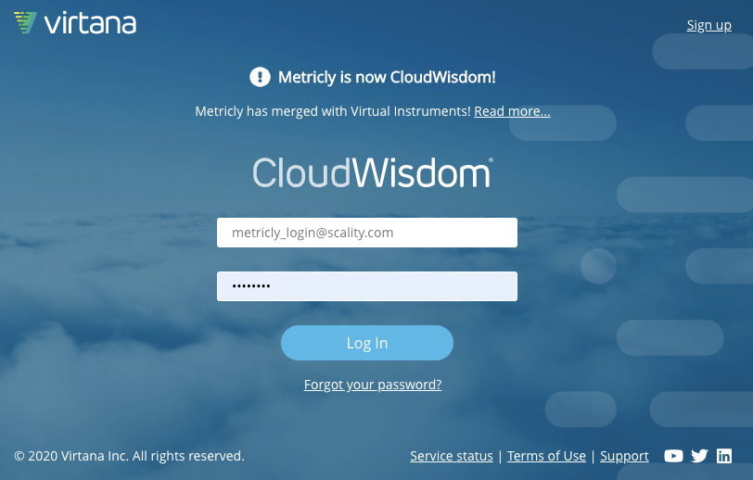
Accessing Cloud Monitor
Contact Scality Support if information missing
To access Cloud Monitor, go to https://app.metricly.com and log in using a valid Metricly login and Metricly API key.

Slide 22
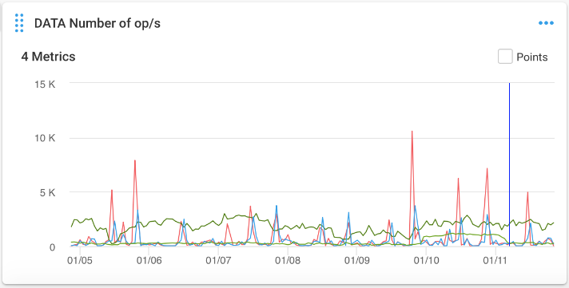
Use Case: Operation Spikes
This graph shows DELETE operations in red, which are spiking irregularly from a near zero baseline.
Even though these spikes seem to be correlated with smaller spikes for PUT operations in blue, further investigation found a malfunctioning application that was causing unnecessary spikes in disk I/O traffic.

Slide 23
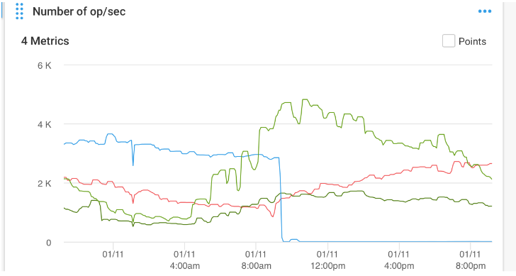
Use Case: Operation Drop-Offs
In this example, the number of PHYSDELETE operations (blue line) drops to zero.
Although this is not necessarily problematic, the drop-off of physical deletes can eventually lead to the filling up of system disk space.
In this case, further investigation determined that the customer had stopped the “purge” tasks during a planned RING maintenance and then forgot to re-enable them.

Slide 24
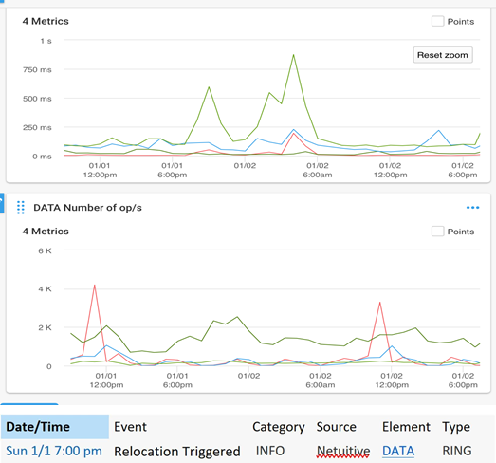
Use Case: Unexplained Latencies
In the latency graph (top graph in the figure) a jump of more than half a second, and then for almost one second, is seen for the GET operation latencies (green line).
Although an increase in the number of operations during the same period could perhaps be the cause of such spikes in latency, the lower graph clearly shows a poor correlation between the number of operations to latency.
Further investigation showed a relocation event (internal maintenance task) was triggered at the start of the spike, which explained the higher latency.

Slide 25
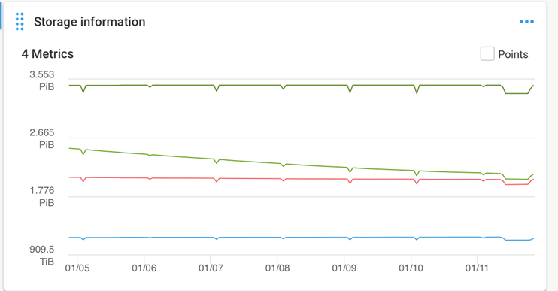
Use Case: Sudden Drop in Used Space
This graph shows a sudden drop in “used volume” space (light green line) for objects stored in the RING.
Also shown are lines for the space ascribed to the "unique volume" (blue line), "stored volume" (red line), and total volume (dark green line).
In this case, the drop was not the result of an unexpected system incident or error, but was the result of the reclamation of space occupied by deleted data.
The graph therefore provides a visual confirmation of this optimization.

Slide 26
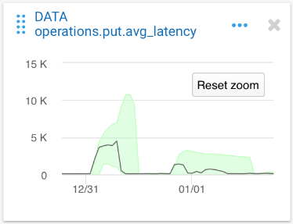
Use Case: Adaptive Alarms on Change
Thanks to a learning process based on historical analysis of a huge amount of data, the Scality Cloud Monitor predicts expected values about the usual functioning of the RING and its components.
The green shaded area represents an expected range of values based on previous statistics as calculated for a given time period.
If the PUT latencies shown in this graph jump beyond the shaded range, an alarm will be triggered.
Rather than trying to set manual alert levels per statistic and per deployment environment, the dynamic Metricly range settings provide a more accurate, seamless and automatic way to notify Scality Customer Service of potential issues.

Slide 27
halod Troubleshooting
halod is the daemon on the Supervisor in charge of sending updates to Metricly.
If Metricly is not displaying updates or is missing data alerts:
Make sure the halod daemon is running properly.
Verify network connectivity to api.app.netuitive.com, port 443.
Check the log messages in /var/log/scality-shalod.log.

Slide 28
ElastAlert
RING 8.5

Slide 29
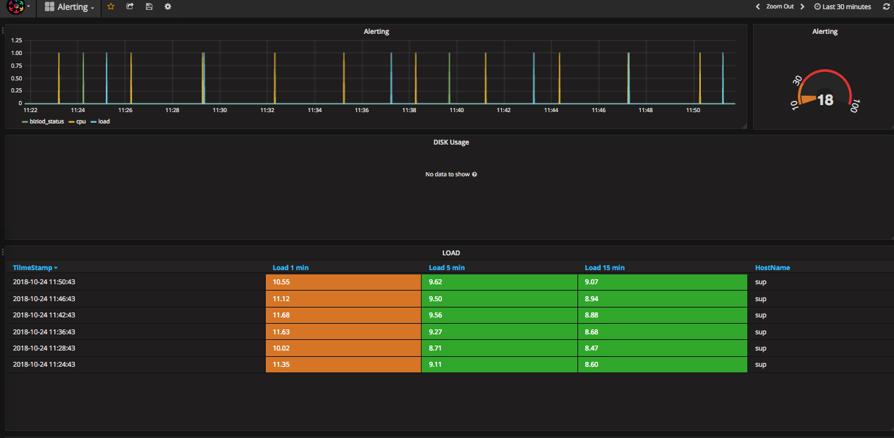
ElastAlert
Elastalert is an alerting service which uses data in Elasticsearch to send monitoring notifications and alarms.
Scality Cloud Monitor must be installed and configured as a requirement: create a Service Request at 🔗https://support.scality.com if needed.
The Alerting dashboard in Grafana displays events created by Elastalert.

Slide 30
ElastAlert Process Flow
scality-elastalert is a daemon that runs on the Scality supervisor.
The daemon queries the Elasticsearch cluster every 3 minutes.
Alerts are sent to Cloud Wisdom (a.k.a Metricly or Netuitive) and then sent along as notifications to regional Scality support teams.
Elastalert alerting rules are found in /etc/scality/elastalert/rules/ on the Scality Supervisor.

Slide 31



ElastAlert Overview
Elasticsearch
Run every 3 min
ElastAlert
Default: send_alert.py
Launch Alert
RING/S3
Stats indices
Execute Rule
(opt) Could send email
Save State
(opt) Could send...
ElastAlert
indices
...
Grafana
Notes:
TODO add herea schema explaining how elastalert gets its events and where it sends it
TODO: Remove Metricly and add Scality Cloud Monitoring for customer video

Slide 32
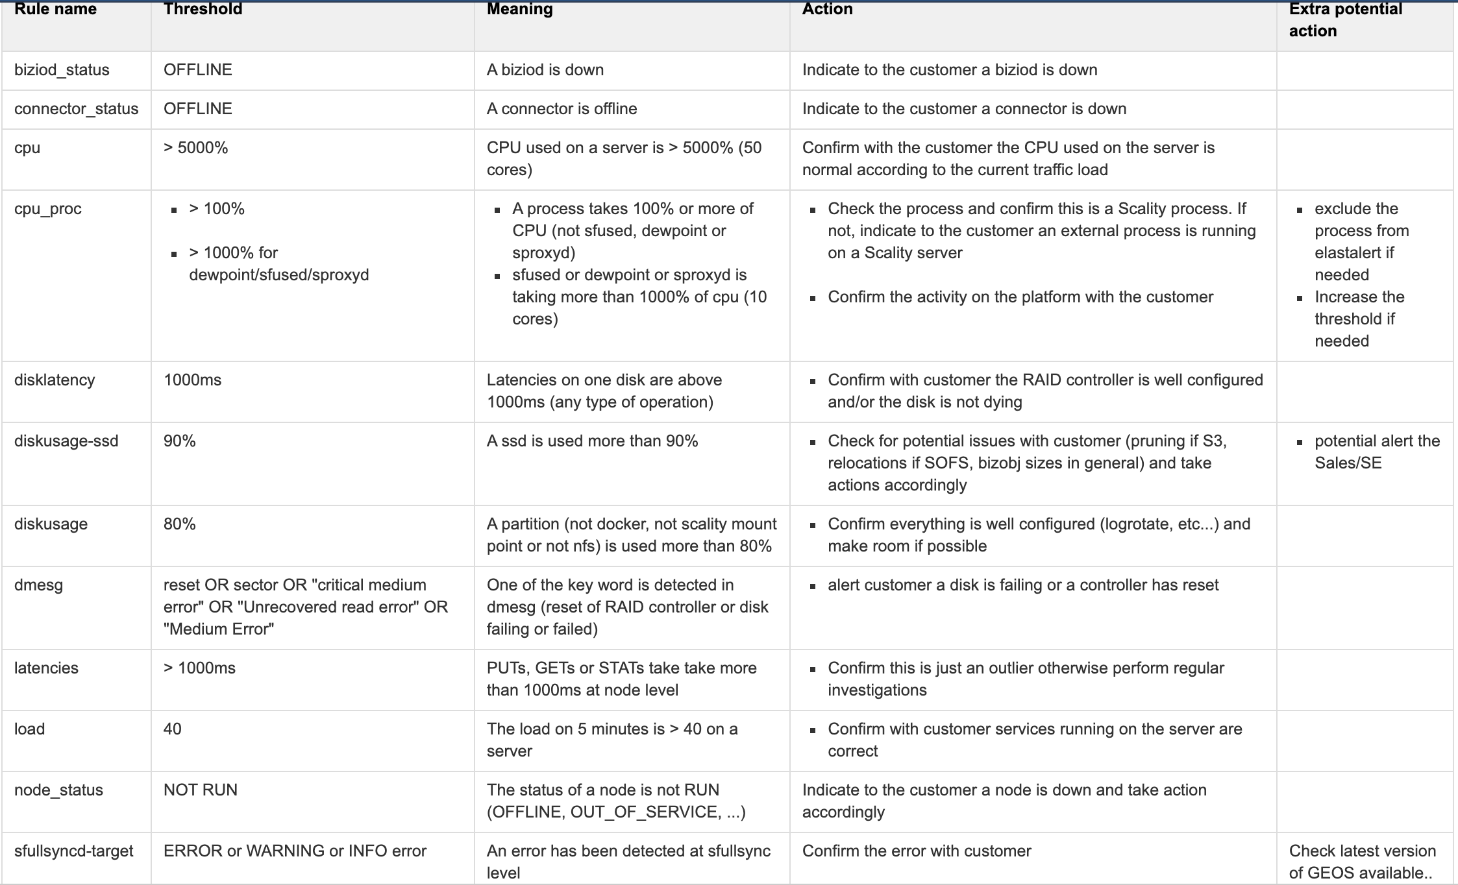
Examples of Rules

Slide 33
Silencing an Alert
Individual alerts can be silenced on the Scality supervisor
For example, to silence the rule scality_cpu.yaml:
➥ no alert will be raised during the next 10 hours.
To cancel a silence:
[supervisor ~]# /usr/bin/scality-elastalert \ --config /etc/scality/elastalert/config.yaml \ --rule /etc/scality/elastalert/rules/scality_cpu.yaml --silence hours=10
[supervisor ~]# /usr/bin/scality-elastalert \ --config /etc/scality/elastalert/config.yaml \ --rule /etc/scality/elastalert/rules/scality_cpu.yaml --silence seconds=0

Slide 34
SNMP
RING 8.5

Slide 35
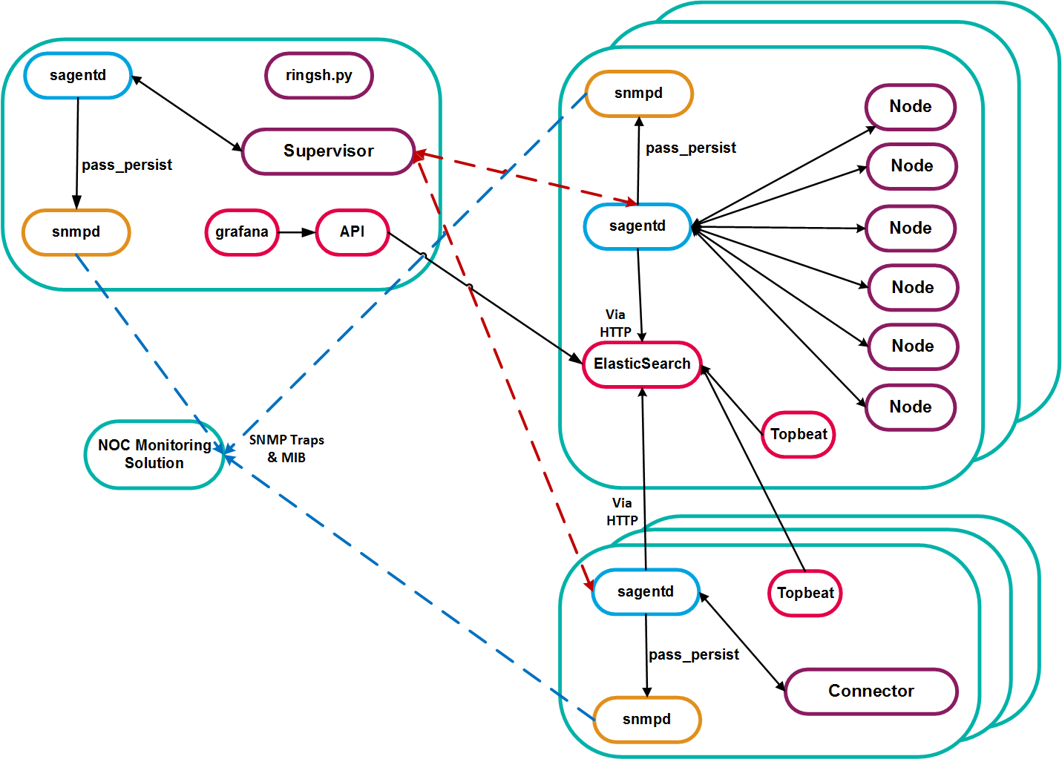
Scality SNMP Architecture Overview

Slide 36
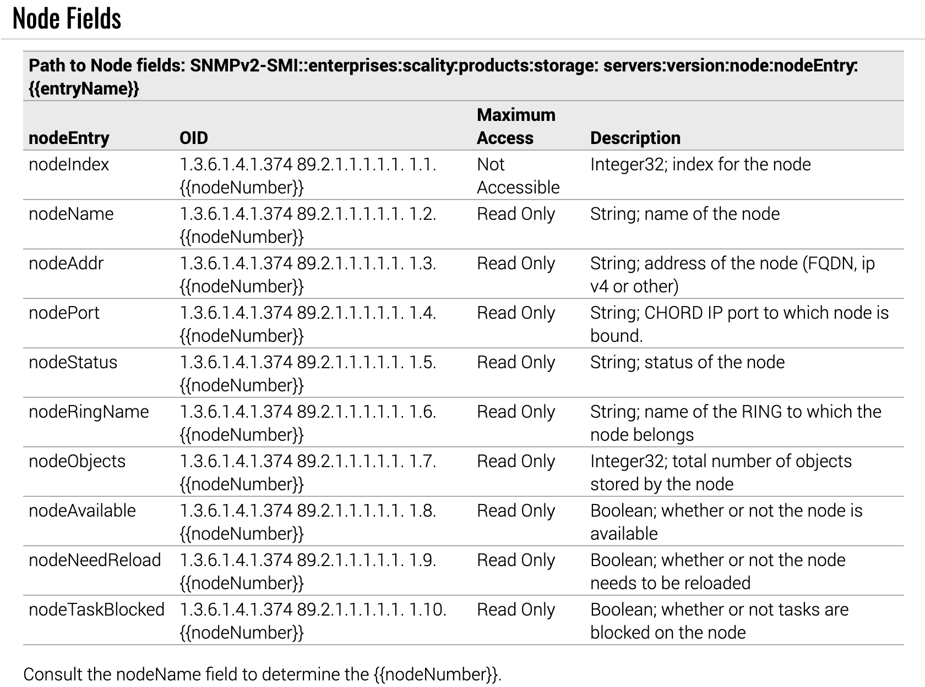
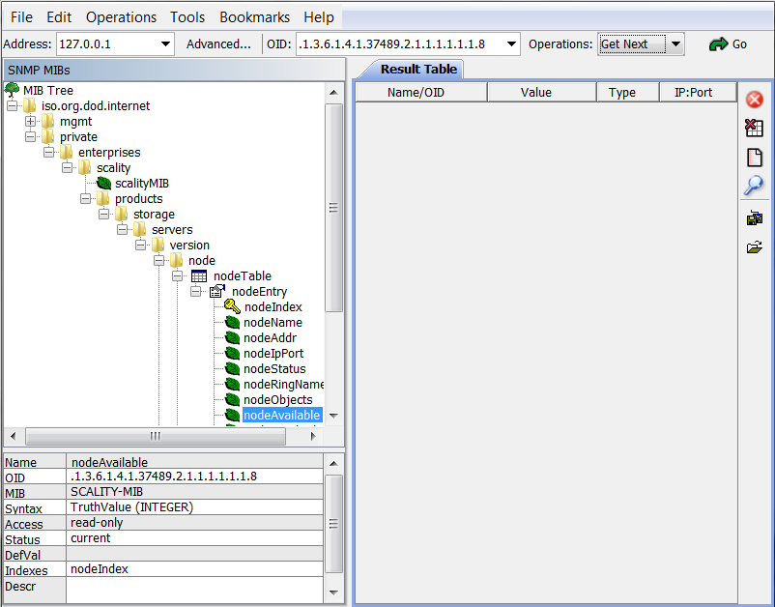
Scality SNMP MIB Field Definitions
For the complete list of OIDs, check out the “Appendix” section in the Scality RING Operations guide found on 🔗https://documentation.scality.com.

Slide 37
SNMP Trap Example
To configure your Scality servers to send SNMP traps:
Edit the trap2sink line in /etc/snmp/snmpd.conf to set the SNMP trap receiver:
Restart snmpd.
On the SNMP trap receiver, edit /etc/snmp/snmptrapd and set the handler. E.g.:
example-script.sh would be a custom executable able to process the trap.
[root@store1 ~]# grep trap2sink /etc/snmp/snmpd.conf
trap2sink <supervisor_IP> public
[root@monitor1 ~]# cat /etc/snmp/snmptrapd.conf
authCommunity log,execute public
traphandle 1.3.6.1.4.1.37489.2.1.1.1.1.3 /root/scripts/example-script.sh

Slide 38
SNMP Exercise

Slide 39
Exercise
Set up snmpd on all Scality servers.
Retrieve the following information with SNMP:
Global state of the RING (Node Status):
Total Capacity available
Disk states of one server
Node process status of one server
For documentation related to this exercise, check out MIB Field Definitions in the Appendix of the Scality RING Operations Guide found on 🔗https://documentation.scality.com.

Slide 40
Solution
SSH to the Supervisor.
Backup the snmpd current configuration:
Overwrite the snmpd configuration file with Scality-ready configuration:
cp /etc/snmp/snmpd.conf /etc/snmp/snmpd.conf.org
cat << EOF > /etc/snmp/snmpd.conf
rocommunity public
syslocation Unknown
syscontact Root <root@localhost>
dontLogTCPWrappersConnects yes
com2sec scality default public
group scalityGrp v1 scality
group scalityGrp v2c scality
group scalityGrp usm scality
access scalityGrp "" any noauth exact all none none
view all included .1 80
includeFile /usr/share/scality-sagentd/snmpd_scality.conf
EOF

Slide 41
Solution (2)
copy the snmpd configuration to all Scality servers:
Restart snmpd on all Scality servers:
Restart sagentd on all Scality servers:
SNMP info retrieval example (get the OID from the MIB Field Definitions tables):
salt-cp '*' /etc/snmp/snmpd.conf /etc/snmp/
salt '*' service.restart snmpd
salt '*' service.restart scality-sagentd
snmpwalk -v2c <SERVER> -c public <OID>
#Example:
#snmpwalk -v2c supervisor -c public 1.3.6.1.4.1.37489.2.1.1.1.4.1.1.2.1

Slide 42
SupAPI
RING 8.5

Slide 43
SupAPI Overview
Supervisor
API for monitoring and administering a RING system.
Also serves as a proxy, passing commands from Grafana to ElasticSearch.
Leverages bizstoresup and supv2 to access RING daemons-specific management interfaces.
Uses a Role-Based Access Control (RBAC) approach to protect from unauthorized access.
For more information, check out “Management Tools” in the Scality RING Operations guide found on 🔗https://documentation.scality.com.
SupAPI
supv2
bizstoresup
ElasticSearch cluster
sagentd
sagentd
NASDK
connectors
nodes

Slide 44
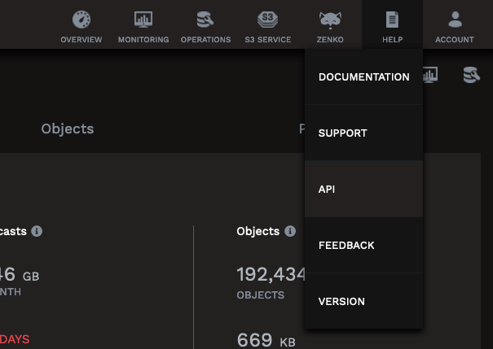
Accessing SupAPI
The API item in the HELP menu on the Supervisor WebUI opens Swagger.
🔗Swagger defines a standard, language-agnostic interface to the REST SupAPI.
Alternatively, to access the SupAPI via Swagger, enter the following URL:
http://{{supervisorHostnameOrIPAddress}}:80/apidoc/

Slide 45
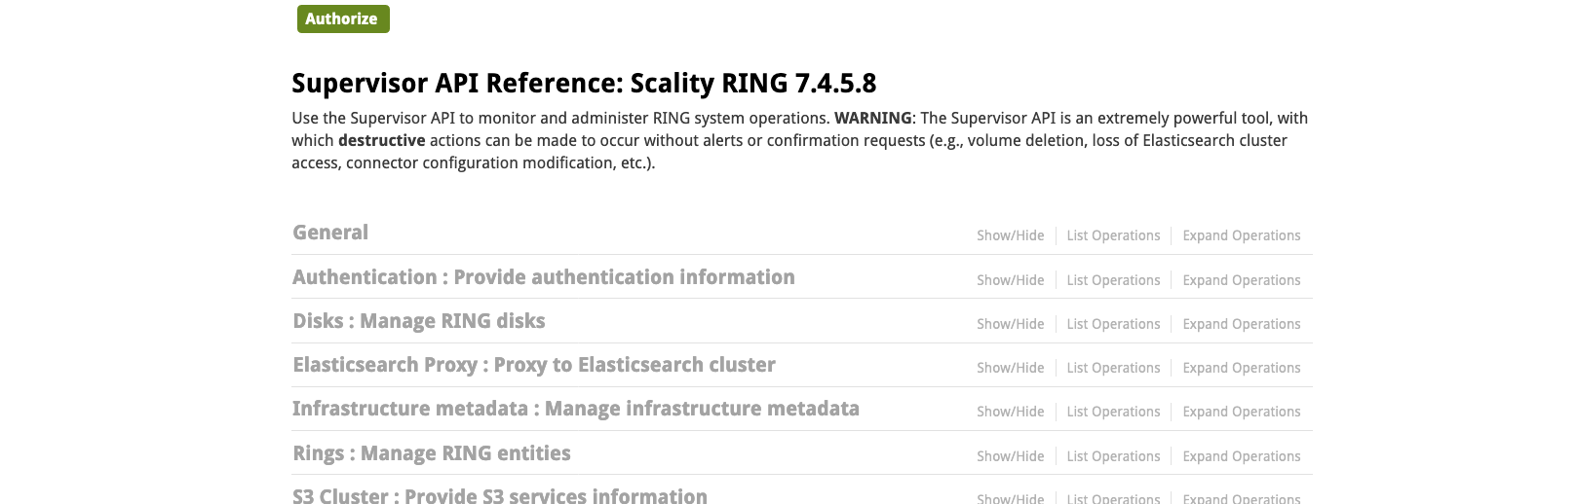
SupAPI URI
Basic authentication can be used when accessing the SupAPI, useful for automation:
http://{{supervisorWebUILogin}}:{{password}}@{{supervisorHostnameOrIPAddress}}:80/api/v0.1/

Slide 46
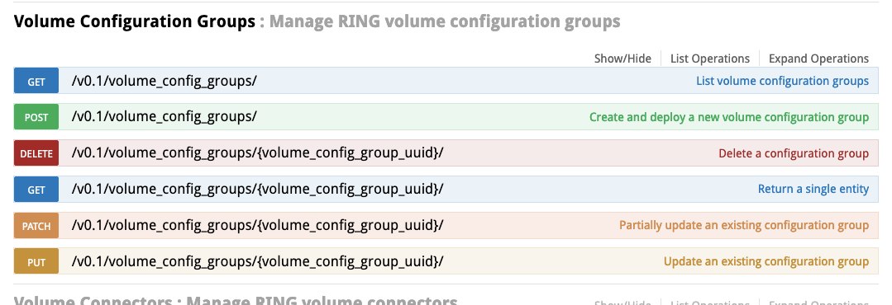
SupAPI Endpoint Example

Slide 47
Troubleshooting SupAPI
To troubleshoot problems presented by SupAPI, check the Response Messages section.
Non-exhaustive list of HTTP response codes:
For more information, check out “RING Operations Troubleshooting” in the Scality RING Operations guide found on 🔗https://documentation.scality.com.
Error Code | Description
200 OK | Standard response for successful HTTP requests.
201 CREATED | The request has been fulfilled, resulting in the creation of a new resource.
204 NO CONTENT | The server successfully processed the request and is not returning any content.
400 BAD REQUEST | The request could not be understood by the server due to malformed syntax.
401 UNAUTHORIZED | The request could not be processed due to missing credentials.
403 FORBIDDEN | The user does not have the permissions necessary to access the resource.
404 NOT FOUND | The requested resource could not be found because the endpoint you want to access is not available for the version of the Supervisor currently running. Check the given URL for the request.
500 INTERNAL SERVER ERROR | Generic error message. Contact Scality Customer Support and provide them with the server logs gathered in /var/log/scality/supapi/uwsgi.log

Slide 48

QUESTIONS ?

